Slide 1

Analysis of key Country Indicators and the Olympics
Presenters:
Nico Boyajian; Alex Fenelon; Jacob Klug; & Louis Mccullagh

Slide 2
Agenda
Project Summary
Data Exploration & Clean Up
Results and Analysis
Further Exploration
Questions

Slide 3
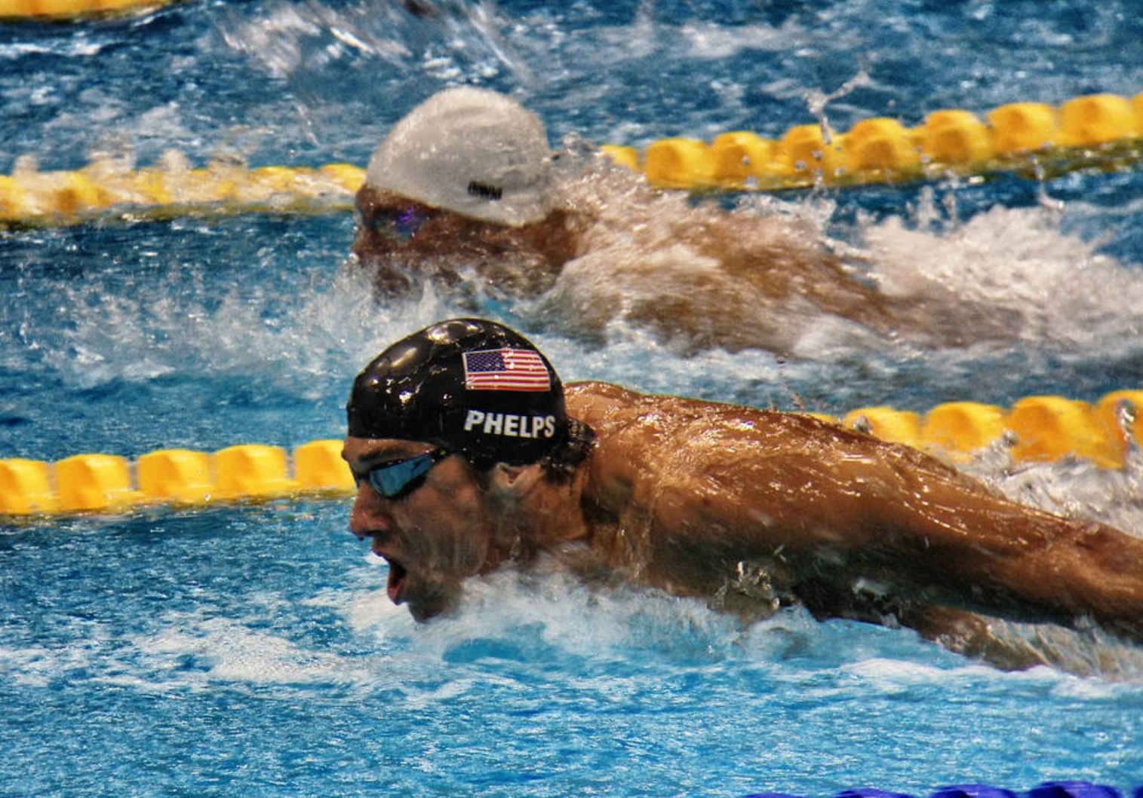
Project Summary
Project:
Back Row Squad (BRS) is interested in determining if a Country’s Olympic performance between 1960 and 2018 is influenced by their gross domestic product (GDP), population or major world events (wars) between 1960 and 2018.
Exploratory Questions:
Does a Country’s GDP have any correlation to the Country’s Olympic performance?
What is the percentage of GDP spent by the Country?
Do the Olympic games have an adverse or beneficial effect on the host Country’s GDP?
How do major events(wars) affect the Country’s Olympic performance & attendance?
Has the age of Olympians increased or decreased over time?
Which sports is the change most prevalent?
Hypothesis:
Country’s with large populations or GDP perform better (medal count) better than countries with low pop
Country’s who have participated in major world conflicts attendance and performance declines in the next Olympic event.
The ratio of the US, China and Russia’s male and female competitors will gradually increase over time as their populations increase.

Slide 4

Data Exploration and Clean Up
Sources:
World Bank – Economic Indicators
https://databank.worldbank.org/source/world-development-indicators
https://data.worldbank.org/indicator/ny.gdp.mktp.cd
Kaggle –
https://www.kaggle.com/the-guardian/olympic-games
https://www.kaggle.com/heesoo37/120-years-of-olympic-history-athletes-and-results
Olympic Api –
https://olympicsapi.docs.apiary.io/#reference/olympics/medals-collection/retrieve-olympic-games
Wikipedia The Free Encyclopedia
https://en.wikipedia.org/wiki/Olympic_Games
Challenges:
Finding sources with Olympic data through 2018 that was exportable
Attempting to use an Api that contained no data
Narrowing down the amount of data we were going to collect
Time period and Counties in scope of original project
Jupiter notebook

Slide 5
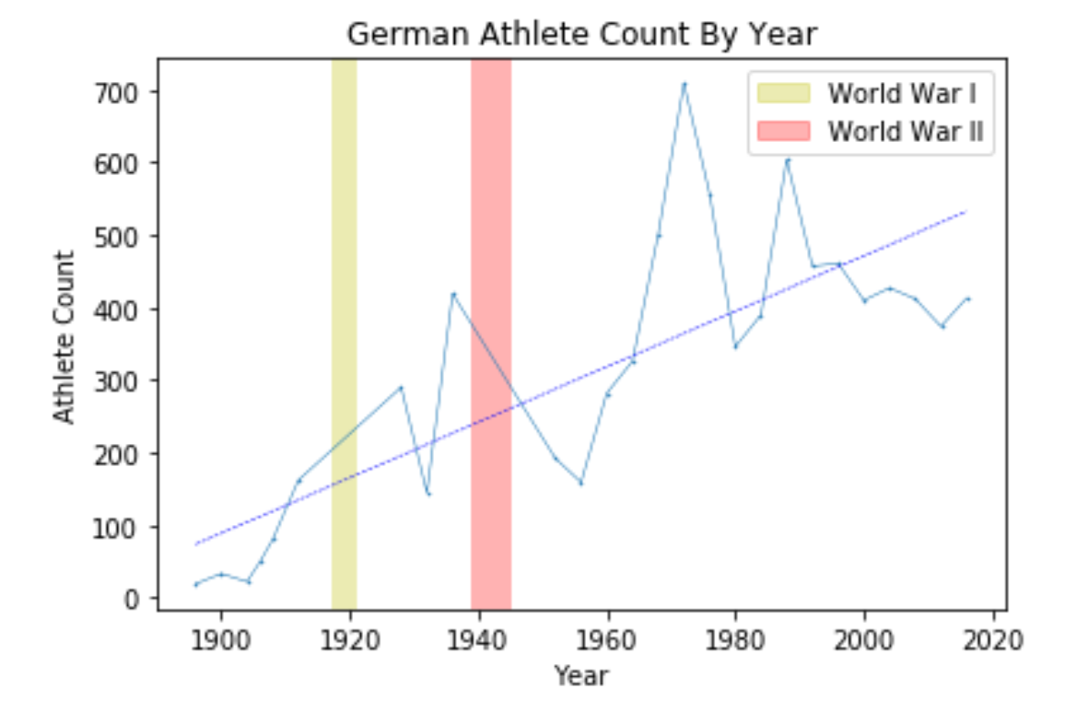
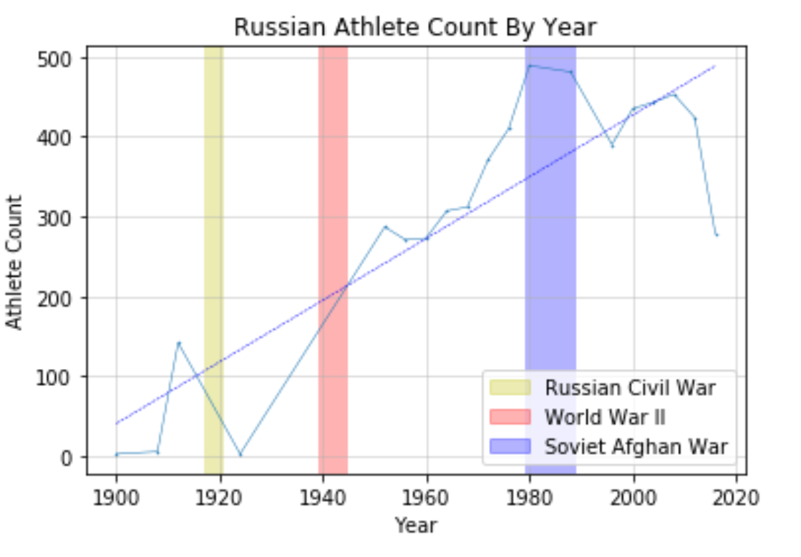
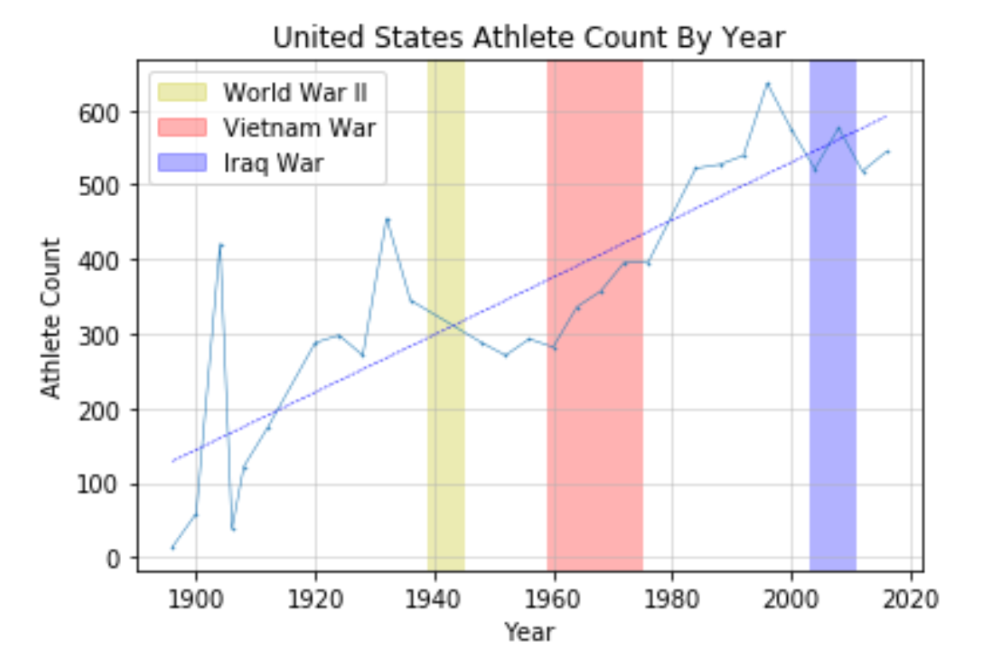
Major Conflicts and the Olympics

Slide 6
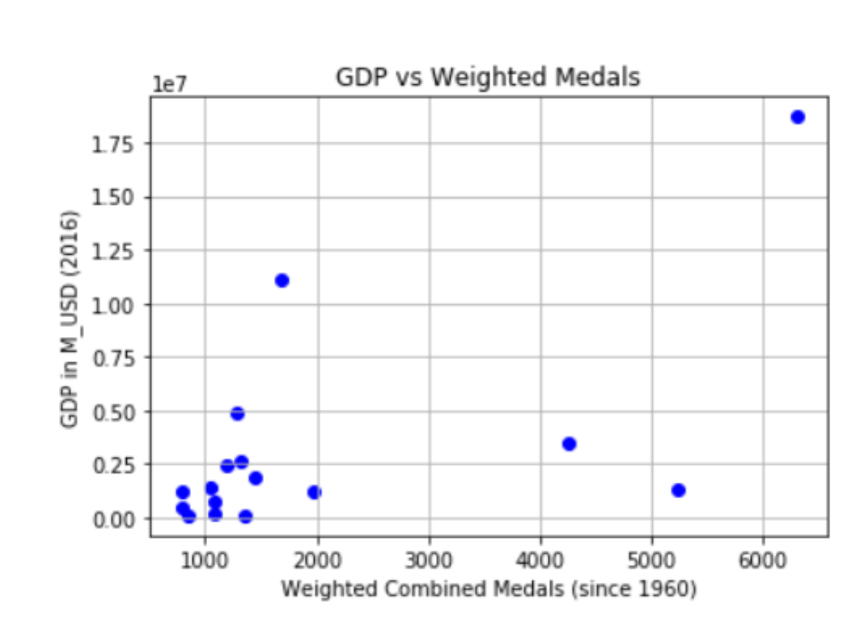
GDP and the Olympics

Slide 7
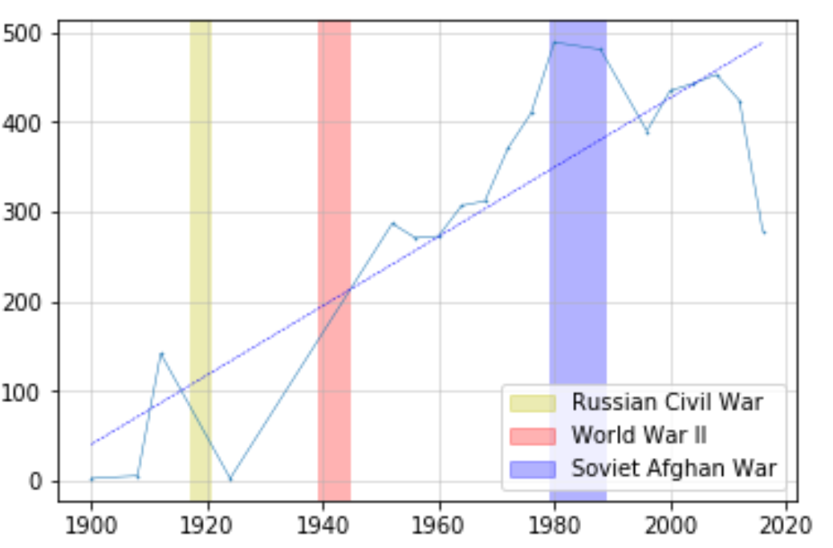
Major Conflicts and the Olympics
The conclusions we found were mostly in line with our hypothesis but not necessarily conclusive. When we review each country, we see that the US had a drop off following WWII and participation remained low throughout the Vietnam war. After the war ended participation increased again with maybe a slight dip during and after the Iraq war.
Russia’s population was decimated by the Russian Revolution and as a result, there were only 3 Russian participants in 1924. Russia did not participate in the Olympic games again until 1948 where participation remained increasingly high until the soviet afghan war and ever since it has been on a decline in both medal count and participation.

Slide 8
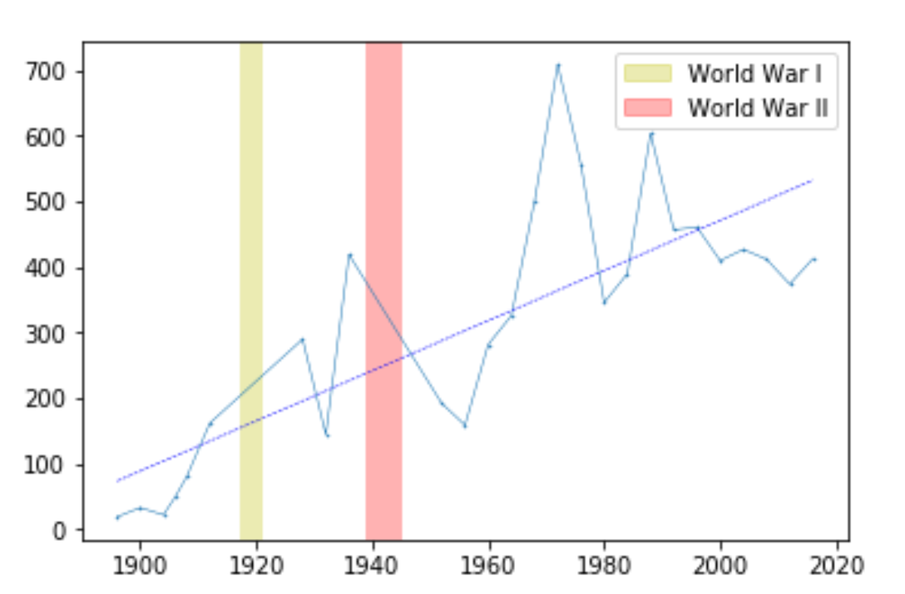
Major Conflicts and the Olympics
Germany’s data is more scattered, but participation peaked in 1936 prior to WWII and then dropped by approximately 230 people in 1948.
For France and Britain, it is difficult to derive any hard conclusions, but participation dropped for an extended period of time following WWII. Interestingly for both, despite steady rise in participation, medal count has been relatively stagnant.
Finally, another accidental finding by tracking medal count throughout the Olympics is correlation between hosting the Olympics and medal count. It isn’t shown in the graphs, however, each dramatic spike in both attendance and medal count is almost always associated with being the host country. This isn’t necessarily surprising, but noteworthy, nonetheless.

Slide 9
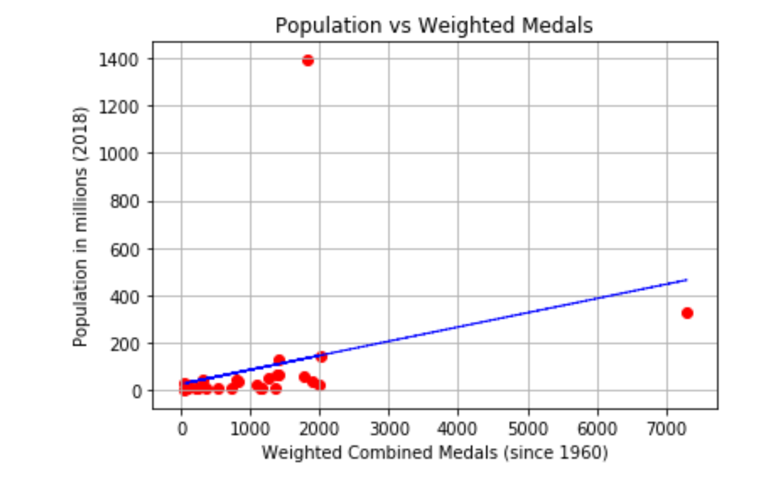
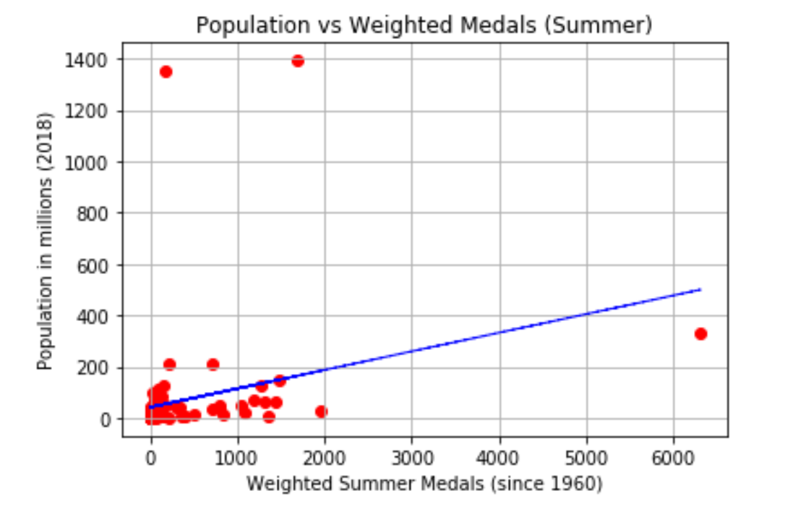
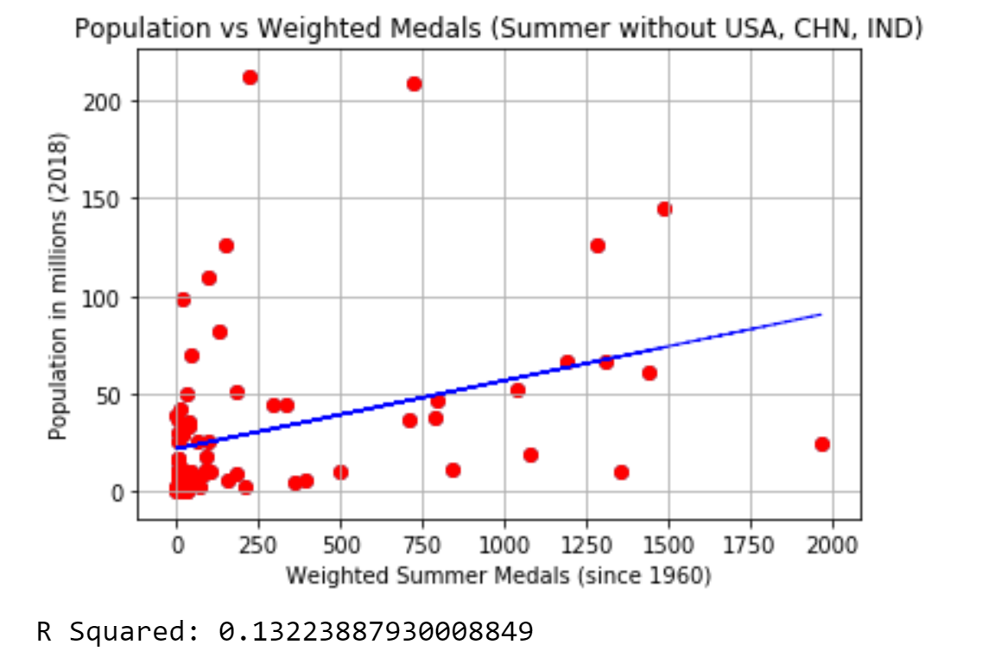
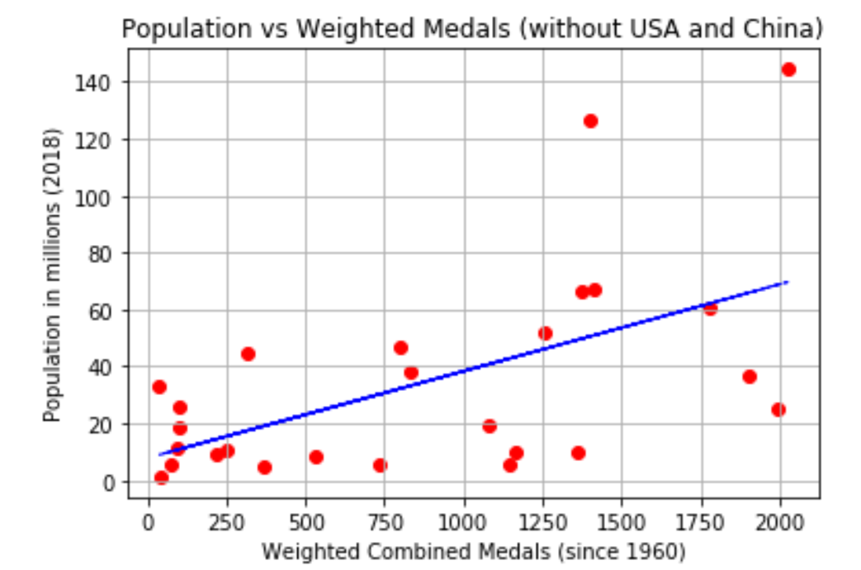
Population and the Olympics

Slide 10
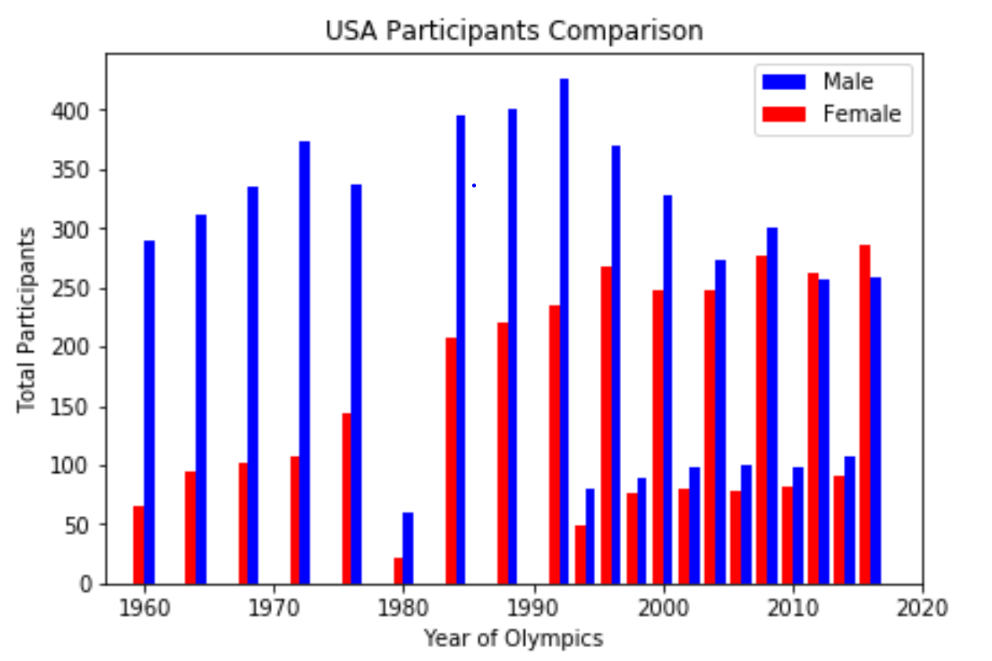
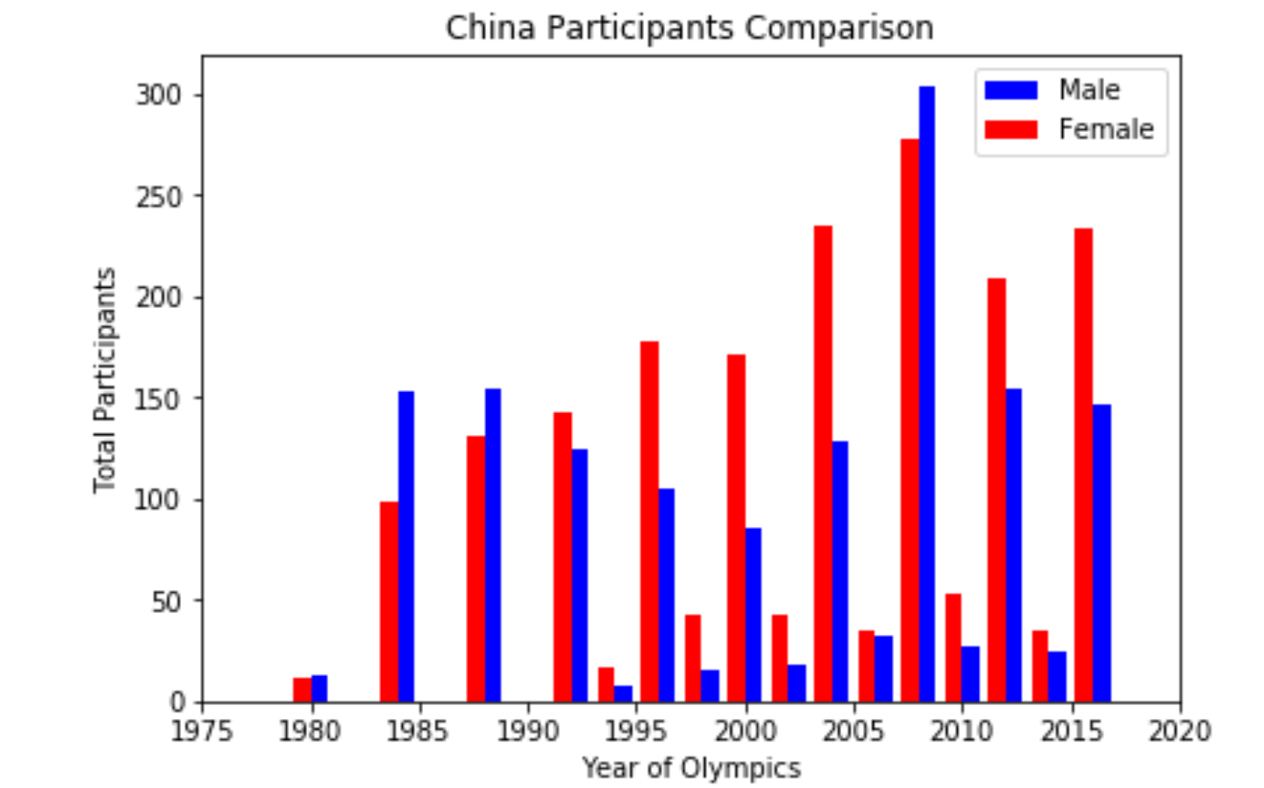
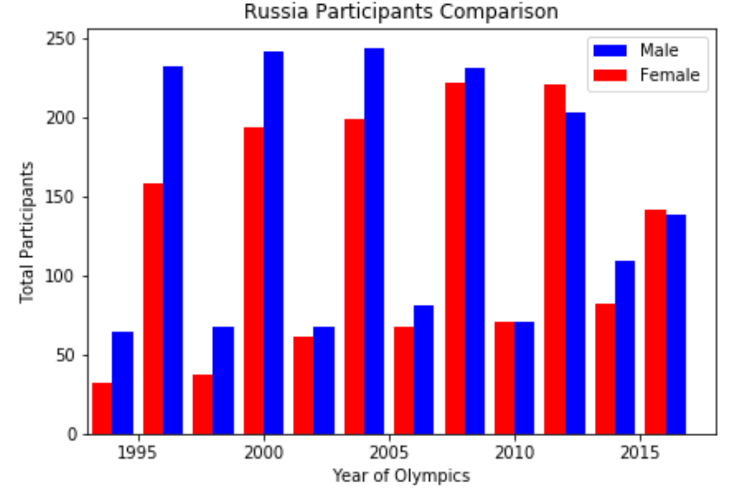
Gender Disparities and the Olympics

Slide 11

Additional Questions to Explore
How has the cost of the Olympics changed over time?
What is the difference between the host country’s GDP and cost of hosting?
Does the country hosting the Olympics improve their economic standing and tourism industry post the Olympic games? If so, is there a plateau? If not, how long does it take them to recover?
Is the participation of smaller countries dependent on the host country proximity or Olympic season?
Have other major world events or scandals (i.e. doping, referring, etc.) have an affect on a Country’s participation?
Could we predict which countries will win the winter Olympics and their medal count?

Slide 12

Questions??

